Slide 1
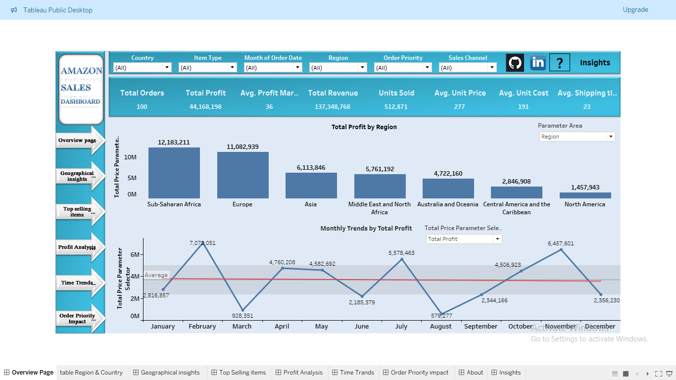
Amazon Sales Analysis Report
Subtitle: Insights and Strategies for Cost Reduction and Profit Maximization
by – Akash Shital Patil U.M. ID – UMIP5670

Slide 2
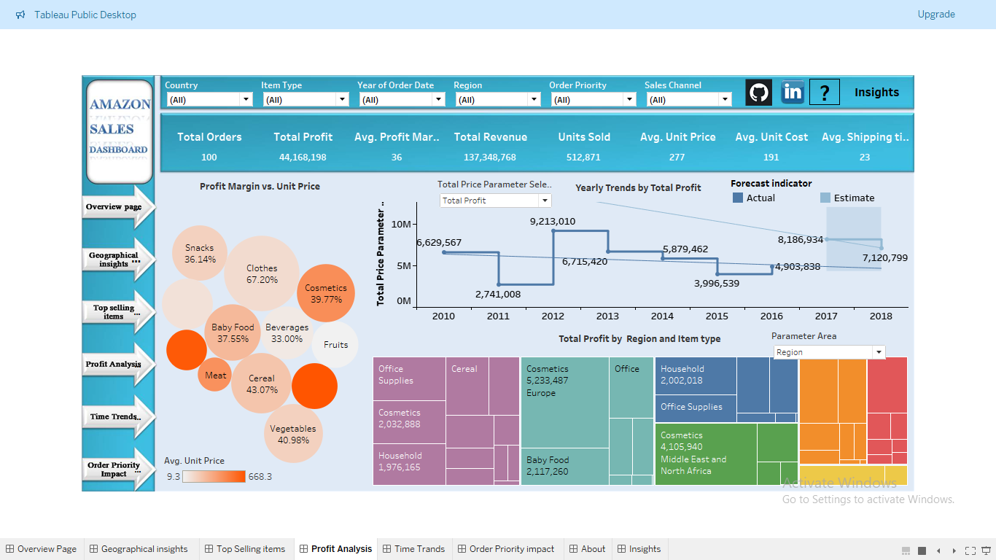
Summary
Overview:
- The Executive Summary provides a concise overview of the Sales Management Report.
- It encapsulates key insights and recommendations derived from the analysis of the Amazon dataset.
Key Findings:
1. Monthly Sales Trend:
- Highlighted opportunities for targeted promotions and marketing strategies to capitalize on peak sales months.
2. Yearly Sales Trend:
- Revealed variations in revenue and profit across different years.
3. Monthly-Year Sales Trend:
- Highlighted nuanced variations in sales performance within specific months of each year.
4. Region-wise Analysis:
- Identified least profitable regions for targeted interventions.
5. Order Priority and Shipping:
- Proposed strategies to optimize shipping costs while maintaining service quality.
Recommendations:
- Implement targeted promotions and marketing strategies during peak sales months.
- Allocate resources towards peak years to maximize profitability.
- Tailor promotional activities based on specific months within each year.
- Offer region-specific discounts or incentives to stimulate sales in underperforming regions.
- Introduce additional charges for expedited shipping options on high-priority orders to optimize shipping costs.

Slide 3
Monthly Sales Trend
Insights:
- The 2nd month consistently shows higher revenue and profit sales, followed by the 11th month and then the 7th month.
- Unit sales peak in the 7th month, followed by the 2nd month and then the 5th month.
- High-priced units are predominantly sold in the 11th month, while low-priced units dominate sales in the 5th month.

Slide 4
Yearly Sales Trend
Insights:
- Revenue and profit were highest in the year 2012, followed by 2013 and then 2010.
- Years 2011 and 2015 had comparatively lower revenue and profit.
- There is a slight decrease in overall revenue and profit over the years.

Slide 5
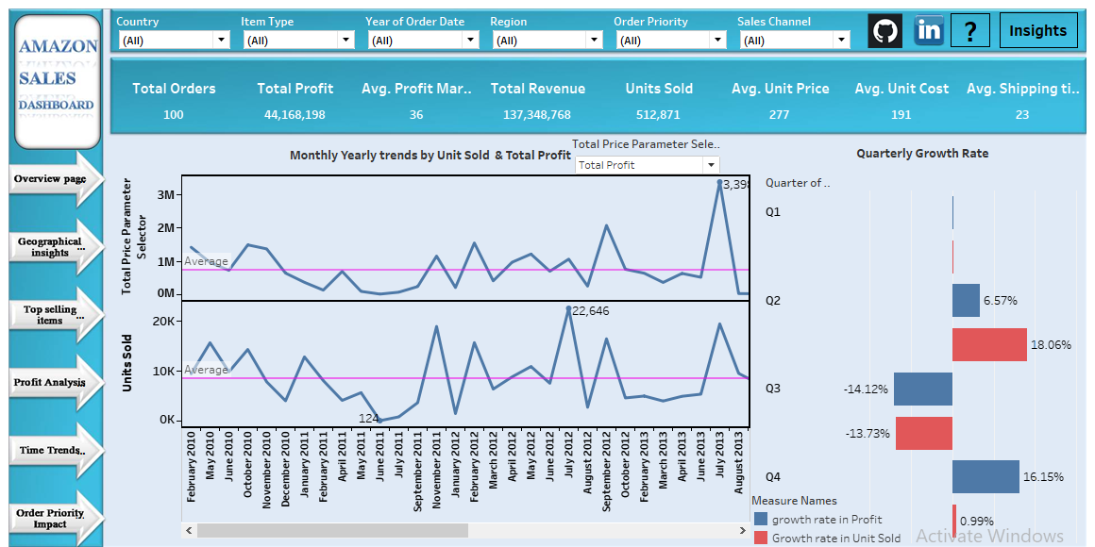
Monthly-Year Sales Trend
Insights:
Focusing on specific months within years reveals interesting variations in sales performance.
Revenue, profit, and unit sales exhibit fluctuations across different months within each year.
July 2013 had high revenue and profit but relatively lower unit sales compared to October 2014 and July 2012.
October 2014 and July 2012 saw high unit sales but comparatively lower revenue and profit.

Slide 6
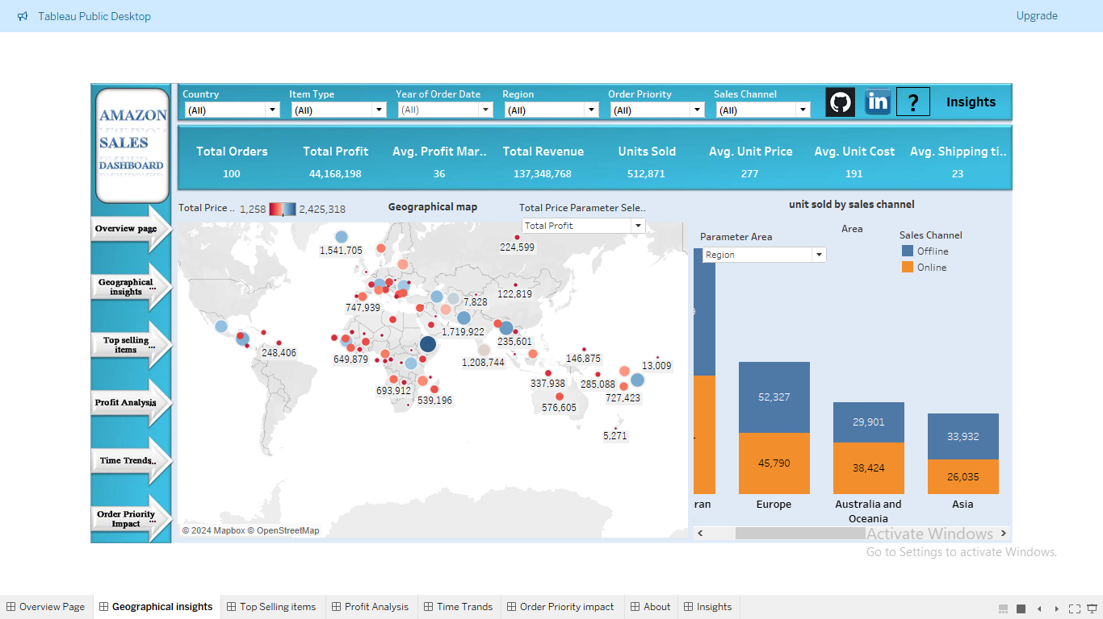
Region-wise Analysis
Insights:
Regions such as Australia, Oceania, Central America, the Caribbean, and North America exhibit lower total profit relative to other regions, considering the number of units sold.
Unit cost remains consistent across all regions.
Order priorities vary geographically: Australia tends to have more high and medium priority orders, while Asia and the Middle East lean toward low priority orders.
Different regions experience varied high sales days, suggesting potential cultural or economic influences on consumer behavior.
Visual Representation:
Insert Tableau screenshots highlighting regional performance and insights.
Utilize maps, bar charts, or pie charts to visualize key metrics such as total profit, unit cost, and order priorities across different regions.
Ensure the visuals effectively convey the regional variations in sales performance and order characteristics.
Use color coding or annotations to draw attention to significant insights within the visuals.

Slide 7
Order Priority and Shipping
Insights:
Analysis of order priority and shipping reveals insights into customer preferences and shipping efficiency.
Mean and median shipping times exhibit slight variations across different order priorities.
High priority orders tend to be shipped faster on average, indicating efficient handling of urgent orders.

Slide 8
Model Performance
Model Training without Total Revenue and Total Cost Features:
Model Used: GradientBoostingRegressor
RMSE: 54887.1971
R2 Score: 0.98
Model Training with Total Revenue and Total Cost Features:
Model Used: Lasso Least Angle Regression
RMSE: 0.0813
R2 Score: 1.0000
Insights:
The Lasso Least Angle Regression model achieved the best performance with the lowest RMSE value of 0.0584 and an R2 score of 1.000.
The model demonstrates high accuracy in predicting the target variable, indicating its effectiveness in the sales management context.
Conclusion:
The inclusion of Total Revenue and Total Cost features significantly improved the model's performance, leading to more accurate predictions.
The Lasso Least Angle Regression model emerged as the top performer, showcasing its potential for accurate sales forecasting in the project context.

Slide 9
Conclusion
Key Points:
The Sales Management Report provides valuable insights into sales trends, regional performance, and order characteristics derived from the analysis of the Amazon dataset.
Key findings include variations in sales performance across different months and years, regional disparities in profitability, and insights into order priority and shipping efficiency.
Recommendations include implementing targeted promotions, allocating resources towards peak years and regions, and optimizing shipping processes to enhance profitability.

Slide 10
Thank You
Akash Shital Patil
UMIP5670

